Slide 1
JARVIS Voice Assistant
Kaniz Fatima-18201030
Mehedi Hasan-18201042

Slide 2
CONTENTS
Functional Requirements.
Hardware Requirements.
Software Requirements.
Design.
Project Features: (Function/ module).
Project block diagram.

Slide 3
FUNCTIONAL REQUIREMENTS
Users will be able to use Voice assistant to do tasks like:
Give simple commands
Converting Text to Speech
Sending Email
Opening Browser
Playing Music
Knowing Time
Hearing Jokes
Reminder Function

Slide 4
HARDWARE REQUIREMENTS
Recommended:
Pentium 4
1GB of RAM
500MB of Hard Drive Space

Slide 5
SOFTWARE REQUIREMENTS
Database- MySQL
Operating System- Windows 10, Linux
ML Model- NLP
Front End- Python GUI
Back End- Python
IDE - PyCharm

Slide 6
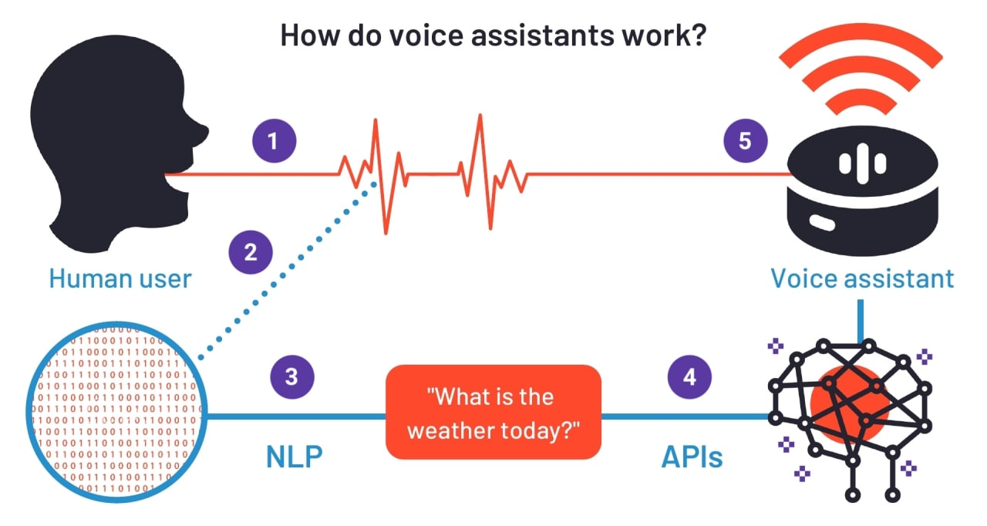
DESIGN STRUCTURE

Slide 7
PROJECT FEATURES (Function/Module)
Capable of executing commands given by user
Let’s us know the time
Can send email if given instruction
Capable of browsing for queries
It can convert text inputs into speech
Could tell a joke as well
Can work as a reminder for any tasks

Slide 8

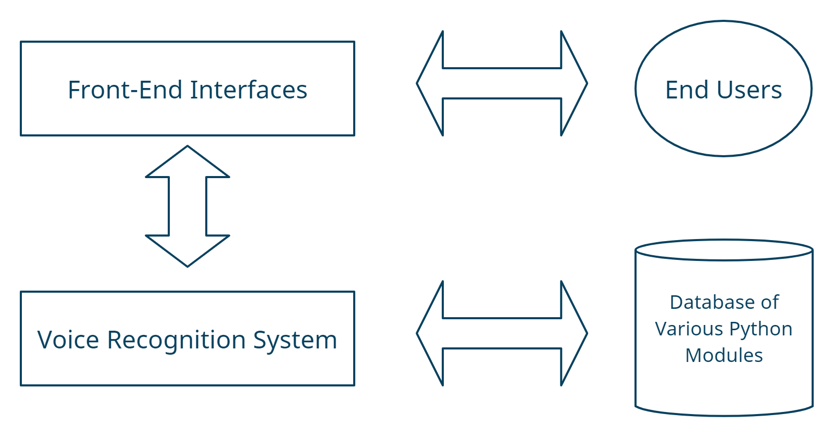
PROJECT BLOCK DIAGRAM

Slide 9
THE END!
Thank You!

